Slide 1
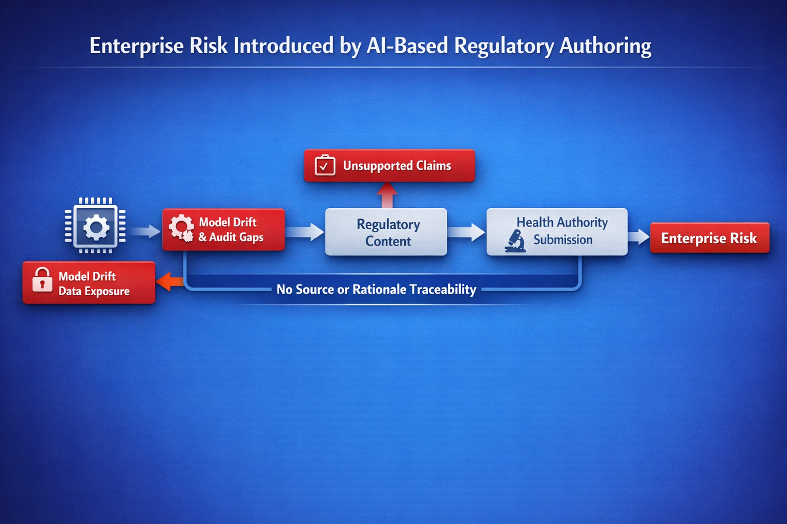
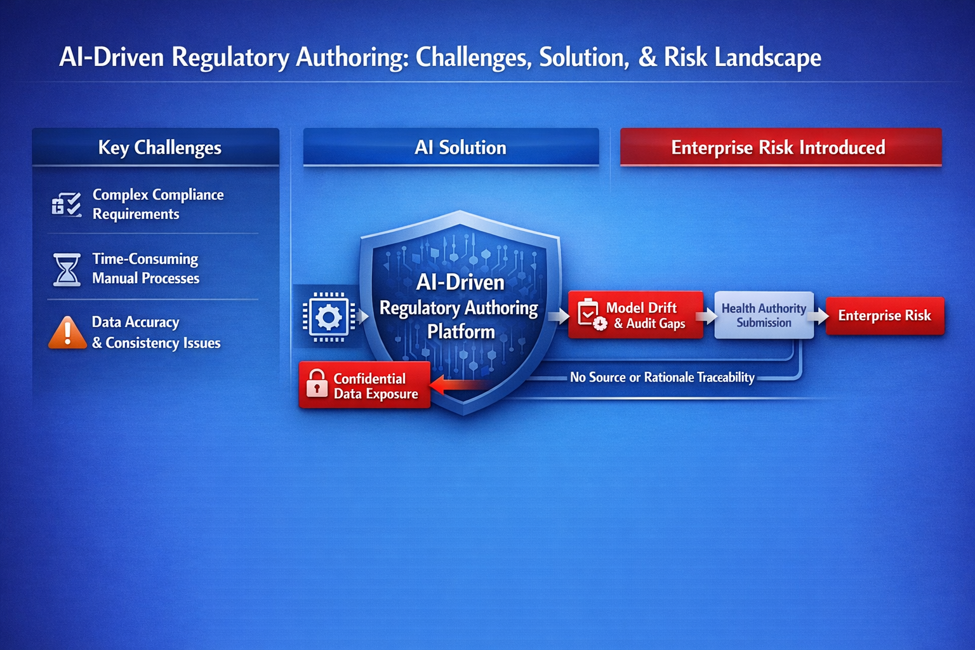

AI-Driven Regulatory Authoring

Slide 2
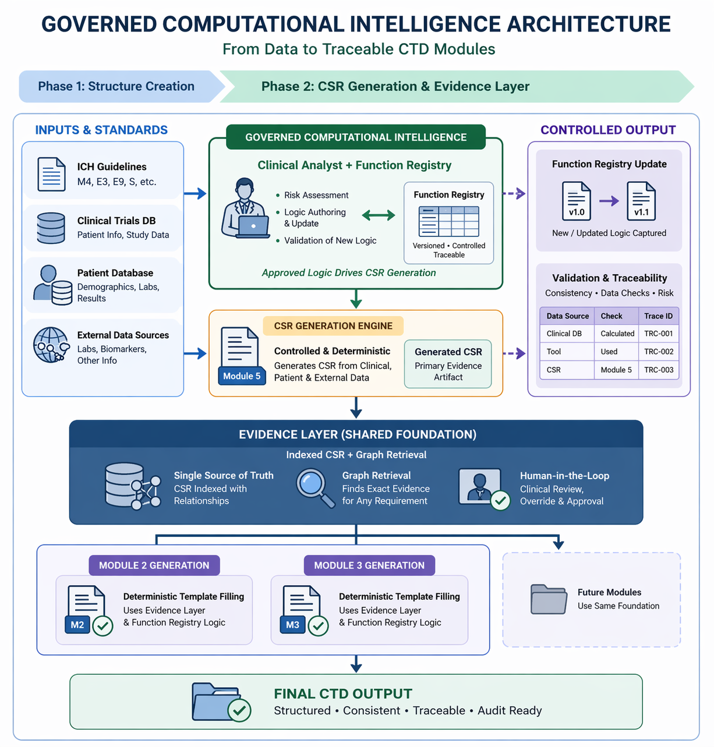
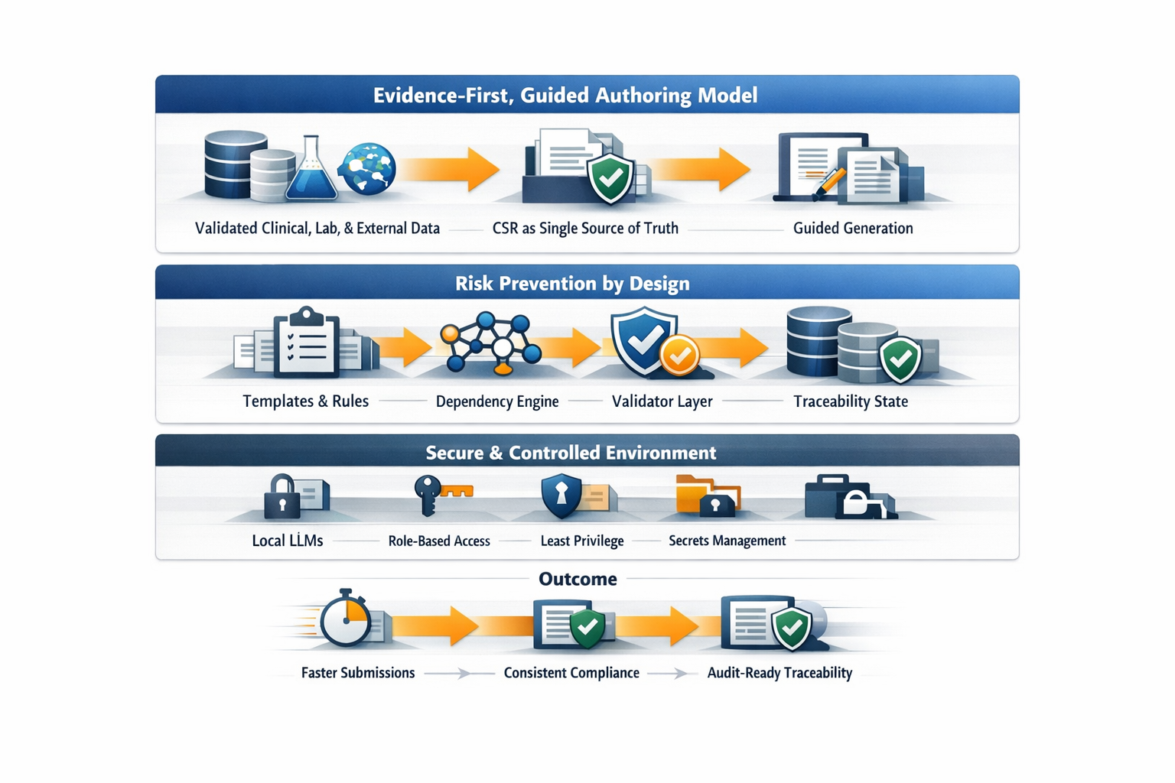
Objective
Design an AI‑powered regulatory authoring platform that accelerates submissions while preserving regulatory control, consistency, and audit‑readiness across the product lifecycle.
Traceability state persistence
CTD Mapping
AI‑driven regulatory authoring that reduces risk, not control.
Data used in demo:Clinical Data: Bells Palsy
https://www.kaggle.com/datasets/dillonmyrick/bells-palsy-clinical-trial

Slide 3
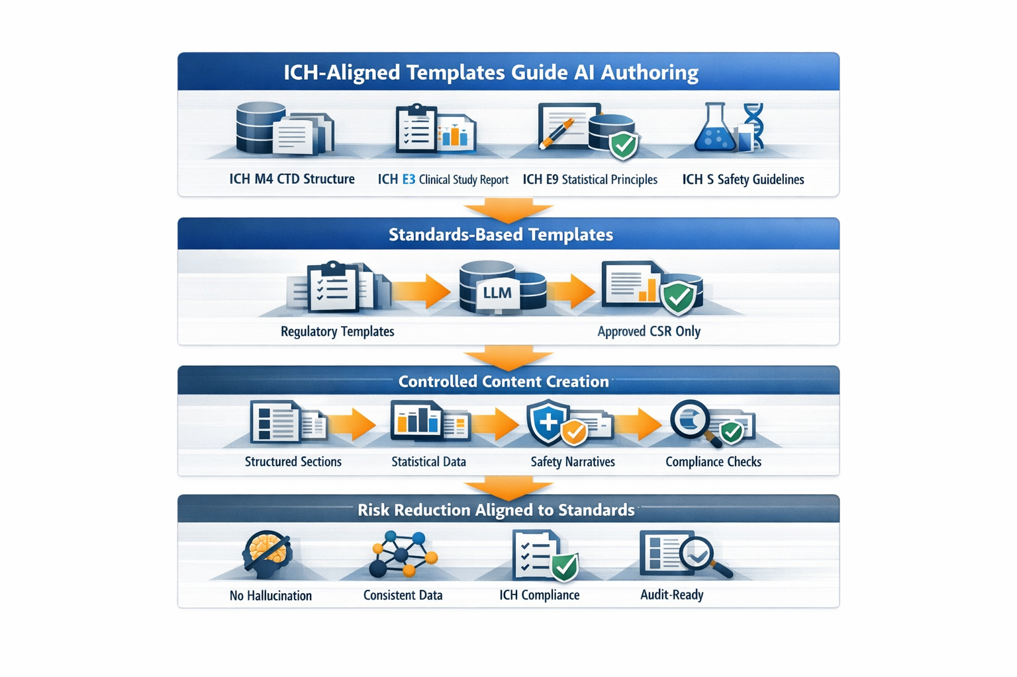
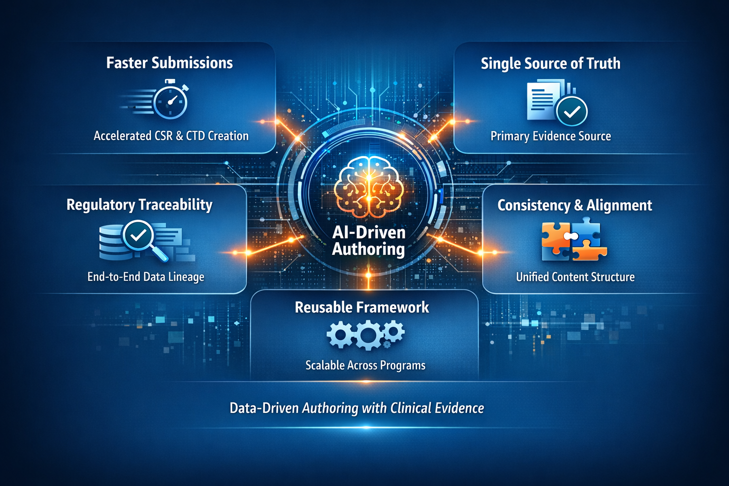
AI-Authoring - How
This platform does not replace regulatory judgment — it operationalizes it.

Slide 4
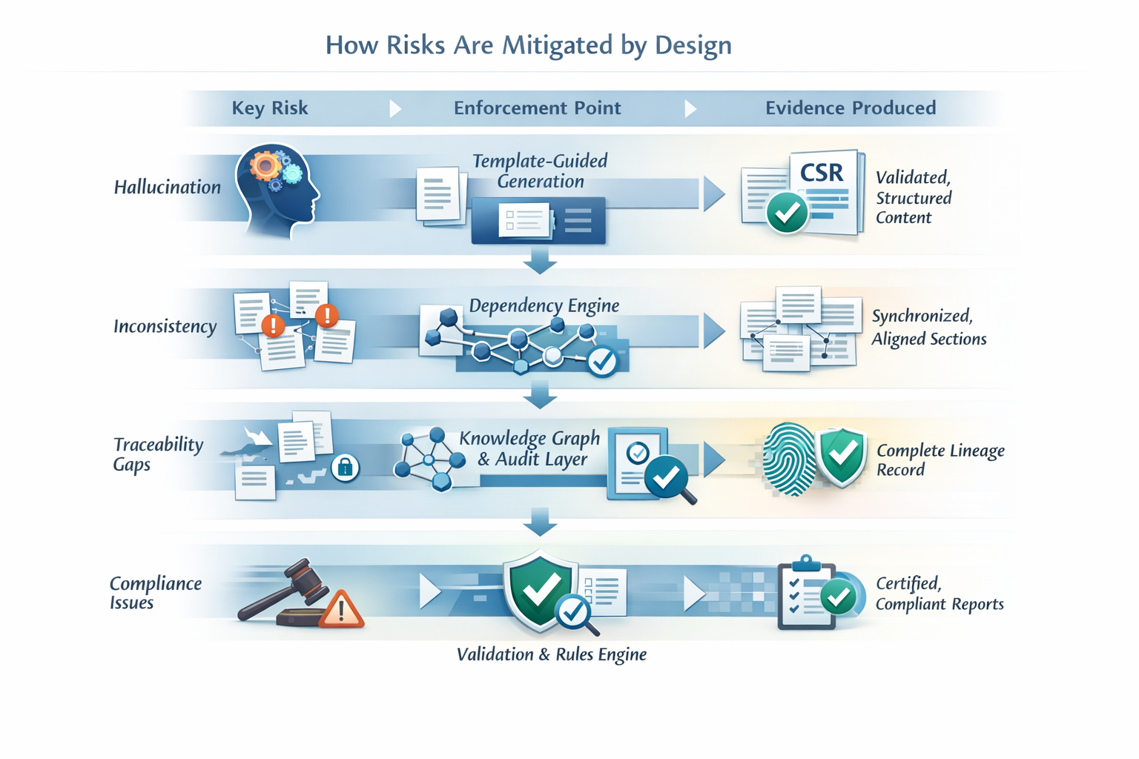
AI-Authoring – Risk Mitigation

Slide 5
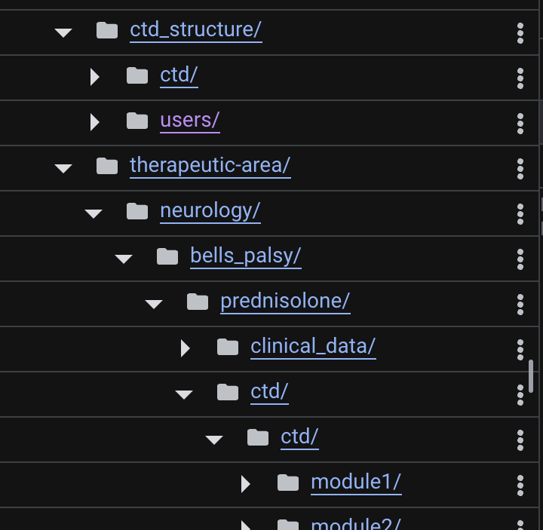
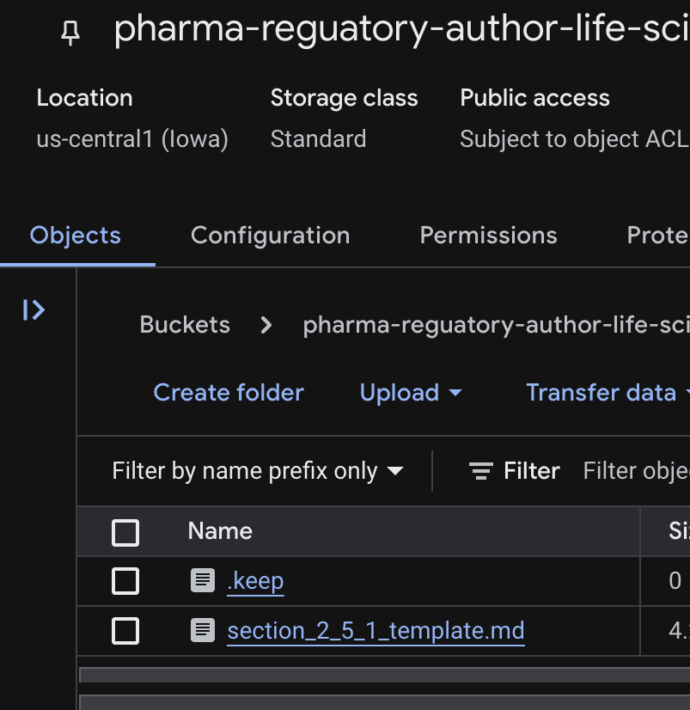
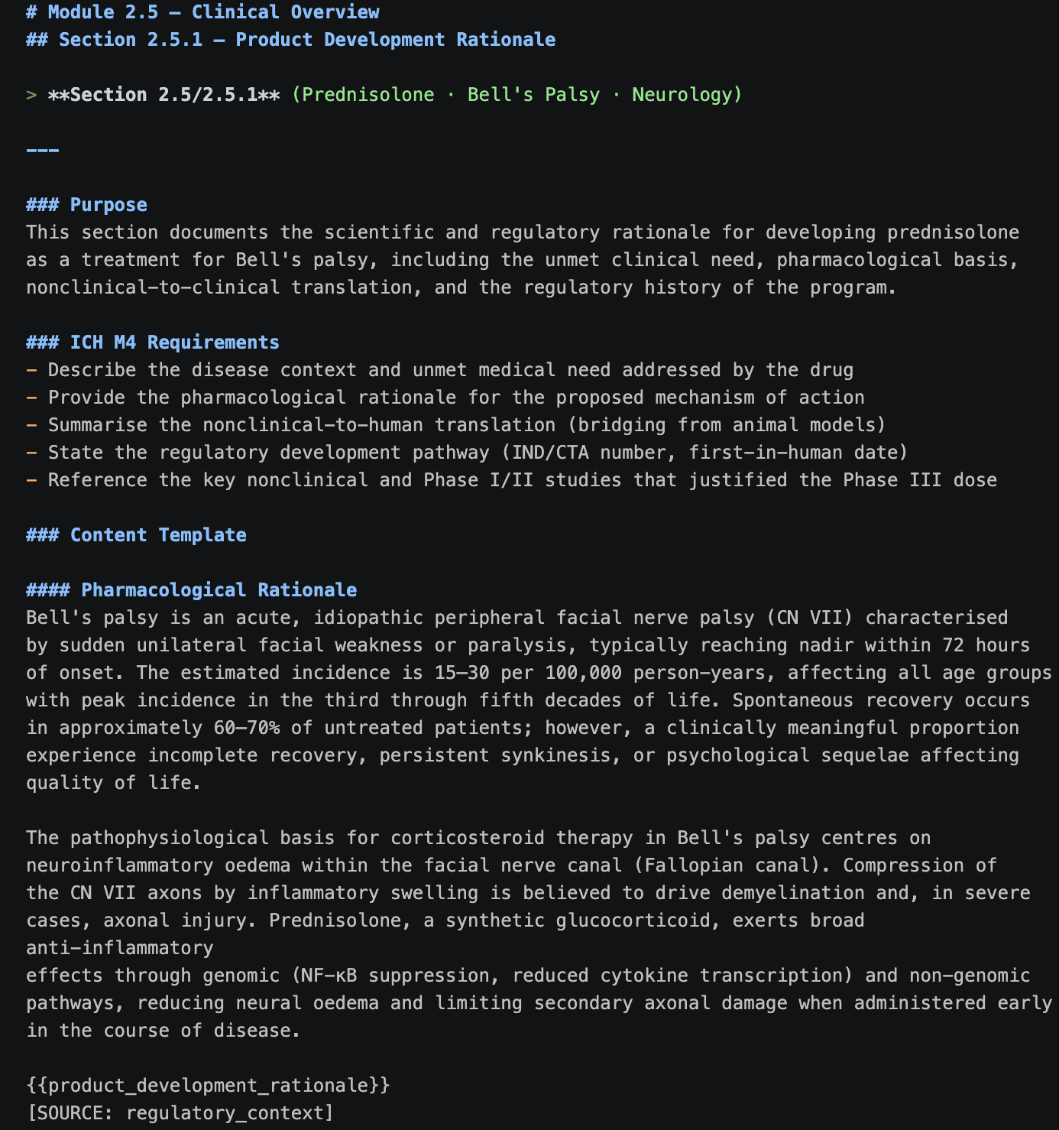
Example: How risk is minimised
Scalable
Privacy protected: Local hosted LLM
Role based Control: Access based on need to know
Least privilege Authentication: No human error
Secret Manager: No accidental leak of data
Notes:
Image source: Microsoft 365 content library AI-driven CTD structure scaffolding enables precise methodology refinement. Compliance officer approval ensures CTD structures are copied to the program level for regulatory alignment. Template generation and mapping to CTD modules involve collaboration among Data-Analyst agents, module-wise personnel, validators, and content writers, with global state management and state persistence for robust workflow control.

Slide 6
Risk-Mitigation
Traditional Authoring | AI‑Driven Authoring
Manual drafting across documents | AI‑assisted, guided content generation
Repetitive copy‑paste | CSR as reusable evidence source
High inconsistency risk | Built‑in data & semantic consistency
Limited traceability | End‑to‑end traceability by design
High review burden | Faster review with aligned content
Risk | Your Control
Hallucination | Template + Analytical Engine
Inconsistency | Dependency Engine
Traceability | Knowledge Graph/Persistence state/validation certificate
Compliance | Validator Layer

